Slide 1


"Whoop Groups": The Value of Consistent Communities

Slide 2

Introduction
Presenter:
Jim Murphy, BBA, M.MFT, LMFT, NBC-HWC
Office of Admissions – 2007-2024
Hullabaloo U Instructor – 2019+
Have been facilitating a variety of small groups for decades

Slide 3
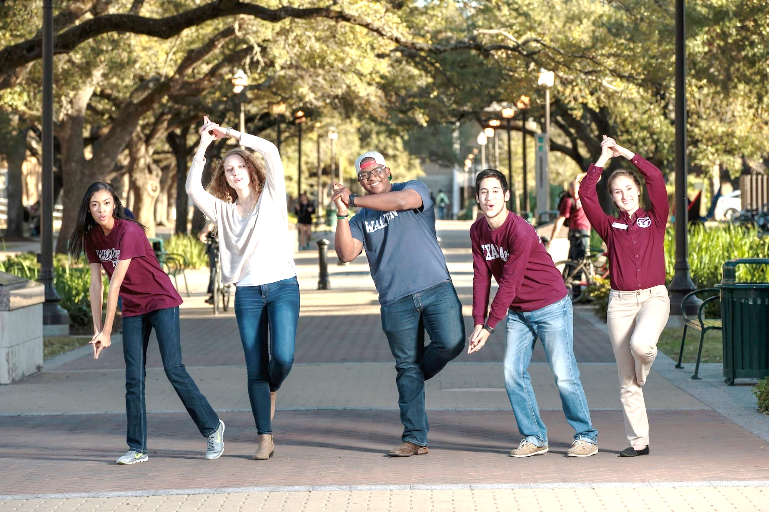
Howdy! Share something good
Share your name and a Whoop!
Notes:
We’ll explore some information about consistent communities in a few minutes, but let’s hop right in and experience some community building.

Slide 4
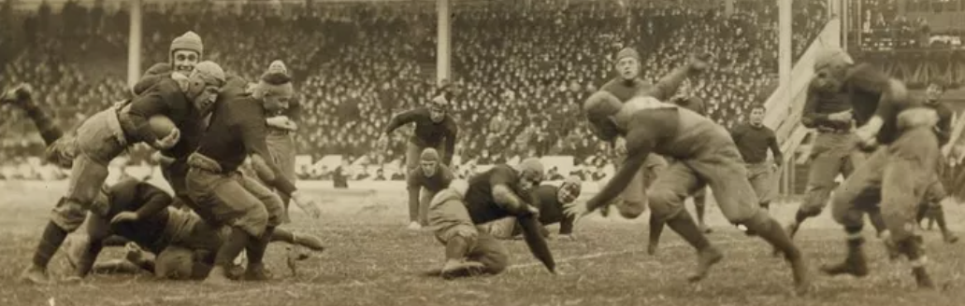
ABOUT “HULLABALOO”
hul·​la·​ba·​loo: informal - a state of commotion - UPROAR, FUSS (merriam-webster.com)
In Aggieland - First word of the “Aggie War Hymn,” by J.V. (Pinky) Wilson while standing guard on the Rhine River during World War I. Why? Who knows.
“Hullabaloo, Caneck! Caneck!” could be 1) the sound a cannon being loaded, 2) the sound of a train rolling through campus, or 3) just part of another crazy football yell (a long line of “autumnal madness” dating back to the Rutgers/Princeton game, November 6, 1869).
More info: tx.ag/HullabalooWord
Notes:
Some of you have taught Hullabaloo U before, but all of us can benefit from a reminder of the meaning of the word Hullabaloo and the purpose of Hullabaloo U. Here are some slides that I’ve presented to students

Slide 5

ABOUT HULLABALOO U You
Hul​la​ba​loo U:
a course to help you navigate the commotion / ”autumnal madness” that is your first semester in Aggieland
Notes:
Hullabaloo U is about the students thriving.

Slide 6
Purpose of Hullabaloo U
The purpose of the First Year Experience is to:
create a welcoming and affirming environment for each new student
Students will develop self-efficacy, self-awareness, and a sense of purpose:
become actively engaged in the learning environment inside and outside of the classroom; and
become socially integrated within the university community.
Notes:
Some excerpts from the course objective

Slide 7
About Community
Community: “a unified body of individuals”
a: the people with common interests living in a particular area
b: a group of people with a common characteristic or interest living together within a larger society
(merriam-webster.com)
Notes:
“Community” defined

Slide 8

Growing Community
Knowing faces/names vs. being known
Occasional vs. regular interactions
Group Work → Team Work
Affinity and Diversity
Valid Levels of Community
Notes:
Ways that community grows – it takes time
Balance of Affinity and Diversity (both exists and are needed)
Valid Levels of Community:
University
Fighting Aggie Class Of / College of / Department of
Class / Club / Cohort / Community Org involvement
Friend Group

Slide 9

Community Building Options
How much of each interaction type to focus on?
Consistent Community-Building Groups
Regular Randomized Interactions
Hybrid
Notes:
Decisions to be made by the HU instructor team. I chose to prioritize consistency amid the “hullabaloo” of the first semester

Slide 10
Whoop Groups:
1
2
Four to six students
Four to six students
3
4
5
Four to six students
Four to six students
Four to six students
Notes:
Whoop Groups – specific (affinity: College, gender, etc.). Seating designed to support Whoop Group interaction. Projects, in-class discussions, and lesson debriefing are accomplished via Whoop Groups – see next slide.

Slide 11

Whoop Groups:
Life Maps and Goals
“Do You Know” presentations
Debriefs
In-class Group Work
Whole Class Discussion Fallback
Notes:
Whoop Groups have come in useful in promoting ownership, involvement, and discussion. They have cyclical benefits – more trust, more involvement, more involvement, more discussion, more group-level discussion, more class-level discussion.

Slide 12


Community Guidelines
Notes:
Whoop Groups also provide a smaller, more intimate venue where a) deeper sharing can naturally occur, and b) where the “keep it here” guideline
Our core Community Guidelines: 1) keep things that are talked about in our class (don’t gossip to others), 2) be kind and nice in your words and actions

Slide 13

Introductions
Notes:
These basic introductions get a Whoop Group going but can also occur with the occasional interaction with other members of the class – during mixer style meet-your-classmates and other activities. Consistent community groups, started with these types of introductions but grown beyond (deeper sharing, support give a homebase to work from.

Slide 14
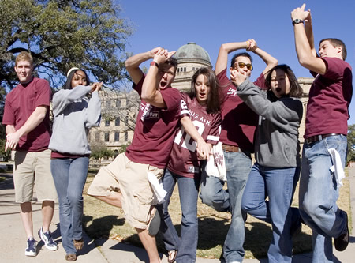
Howdy! What’s Happening?
Whoops!
& Poops!
Notes:
In our Whoop Groups, by creating a consistent community for our students, they can share not only teamwork, team building, projects, discussion, but also support. We regularly give them the opportunity in class to share some Whoops and Poops.
Get with the same people you met earlier and share a difficulty (a Poop) from the previous week.

Slide 15

Growing Community Revisited
Being Known
Regular Interactions
Teamwork → team building
Affinity & Diversity
Built-in Discussion Forum
Potential: Offline/Ongoing
Notes:
Randomized interactions have some value, but consistent communities seem to provide so much more to our Hullabaloo U students.

Slide 16
Debrief
Some questions to ponder and share:
What questions/comments do you have about building community?
Any final comments for the good of the group?

Slide 17





Jim Murphy
jdmurphy@tamu.edu
jimdmurphy@gmail.com
979-204-2076 (cell)
@TAMUOSS
@tamuoss
@TAMUOSS
studentsuccess.tamu.edu

